Slide 1

Switches Make Fixes
CPE4020 Device Networks – Kennesaw State University
Team 2 (Switches get Stitches):
Hanson Chaney,
Cooper Newlin,
Chris Turner,
Karolyn Seredick,
Rodrigo Corral

Slide 2
The Problem
Current home automation gurus (Google, Amazon, etc.) often sell your information to 3rd-party companies.
There is a risk of security breaches due to the non-local communications
High risk of your information being leaked, stolen or lost due to off-site and/or 3rd party servers and databases

Slide 3
Our solution
We propose creating a locally run server to conduct home automation
A local server will preserve your data security since there is no 3rd party involvement or outsourcing of your information
You still get to experience the convenience of home automation controlled through a user-friendly phone application

Slide 4

Market/Competition
Google: Google makes many IoT devices that can be used in a residential setting. They have door sensors, window sensors, smart hubs, etc.
Amazon: Creator of Alexa, a massively popular and useful device that can be used to control items in a home or business. They also provide their own IoT service.
LG: Creator of ThinQ, an application that can be used to control appliances in a home.
Samsung: Samsung makes many IoT devices, mainly for entertainment. They released Bixby, a service that can be used on smartphones or household appliances.

Slide 5

Our Unique Features
We provide a centralized user interface that will allow the user to control multiple automated systems (locks, lights, temperature) in the same place.
Our product operates on a localized server. You don't have to worry about a 3rd party having access to sensitive information such as when your doors are unlocked.

Slide 6

Enough With Business, We Are Engineers

Slide 7
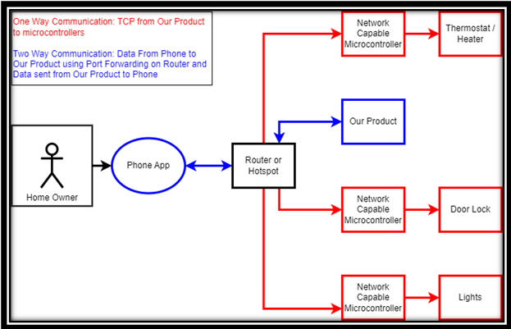
Our Final Product System

Slide 8

How are we demonstrating our system?
Using our phone application, we will send various commands to our Server to relay to our local Raspberries Pis. These Raspberry Pis will be sending and receiving data to do the following: read the temperature, turn a heating pad on and off, control lights, and lock or unlock a door (represented with a servo motor).

Slide 9
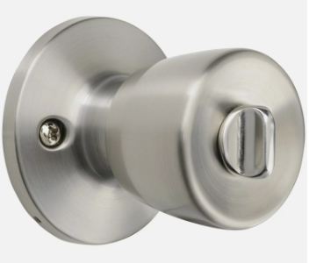
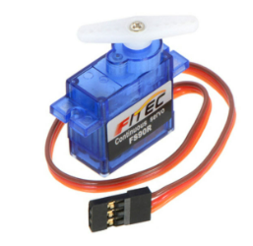

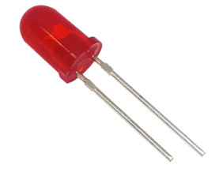
Demo Key
Servo Motor
Door Lock
Light Emitting Diode
Light Bulb

Slide 10
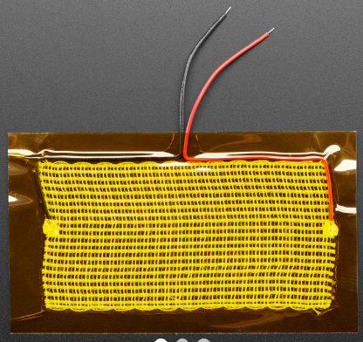
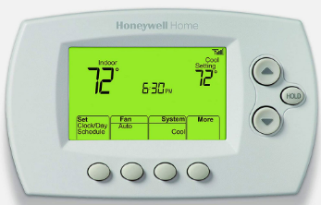
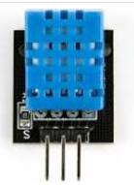
Demo Key
Heating Pad
Thermostat & Heater
Temperature Sensor

Slide 11
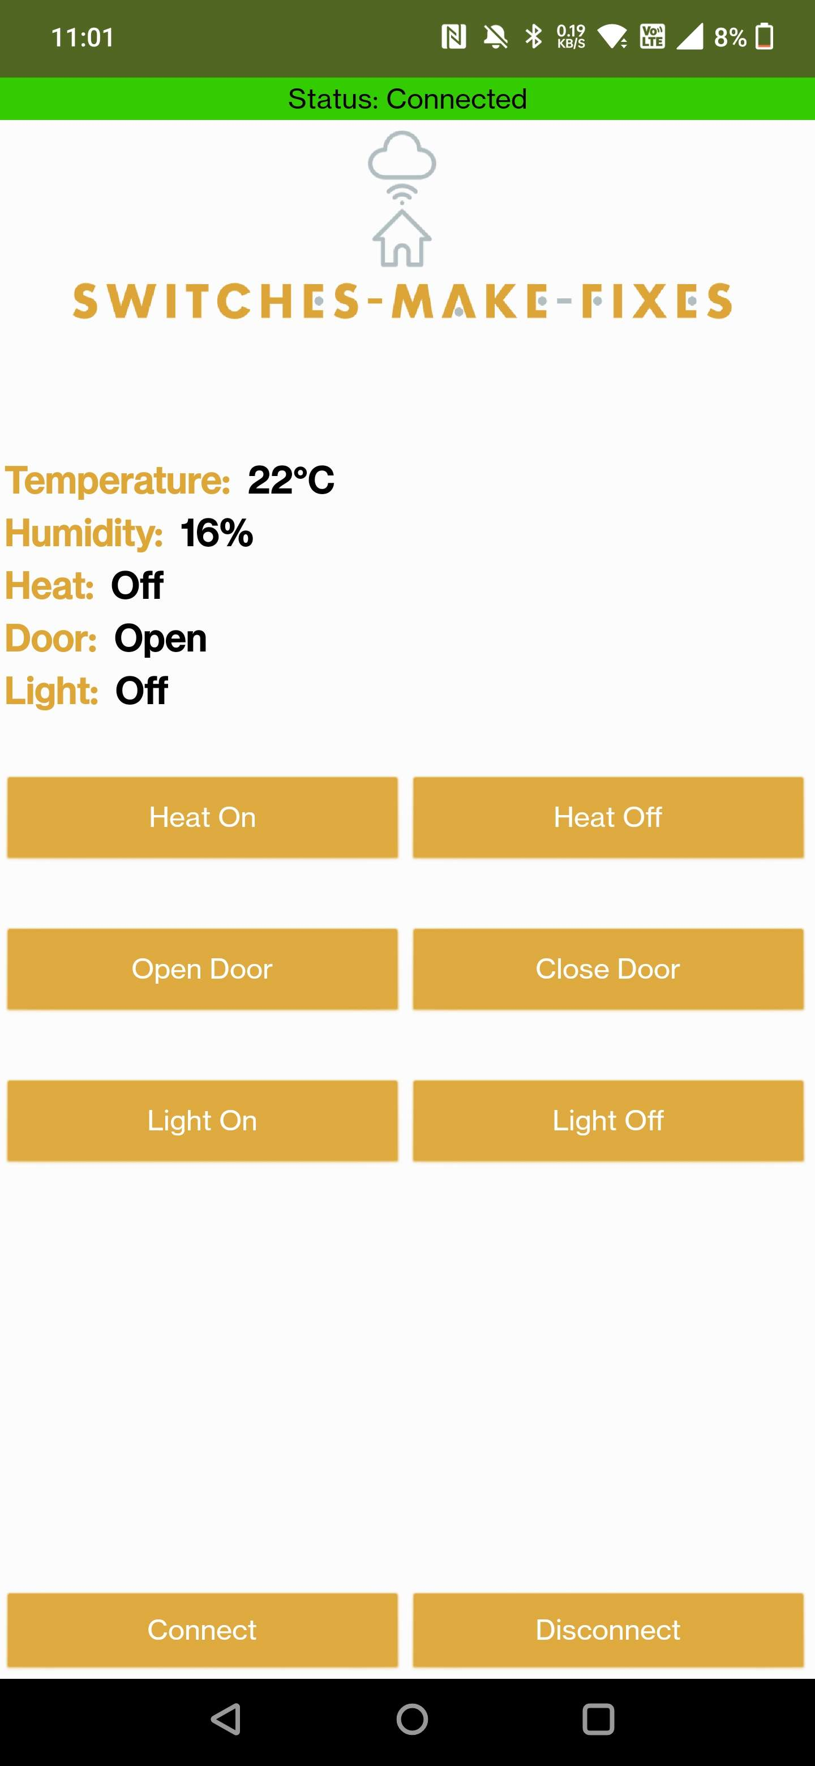
Demo Key
Our Phone App
Phone App

Slide 12
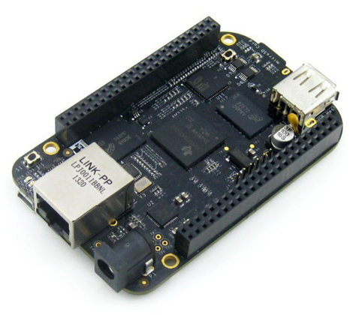
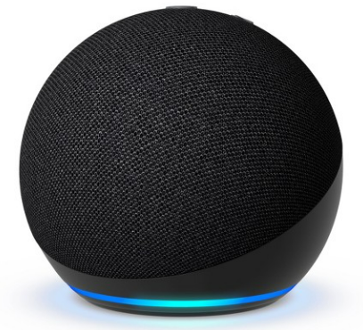
Demo Key
Home Automation Hub
Beagle Bone Black

Slide 13


